Slide 2
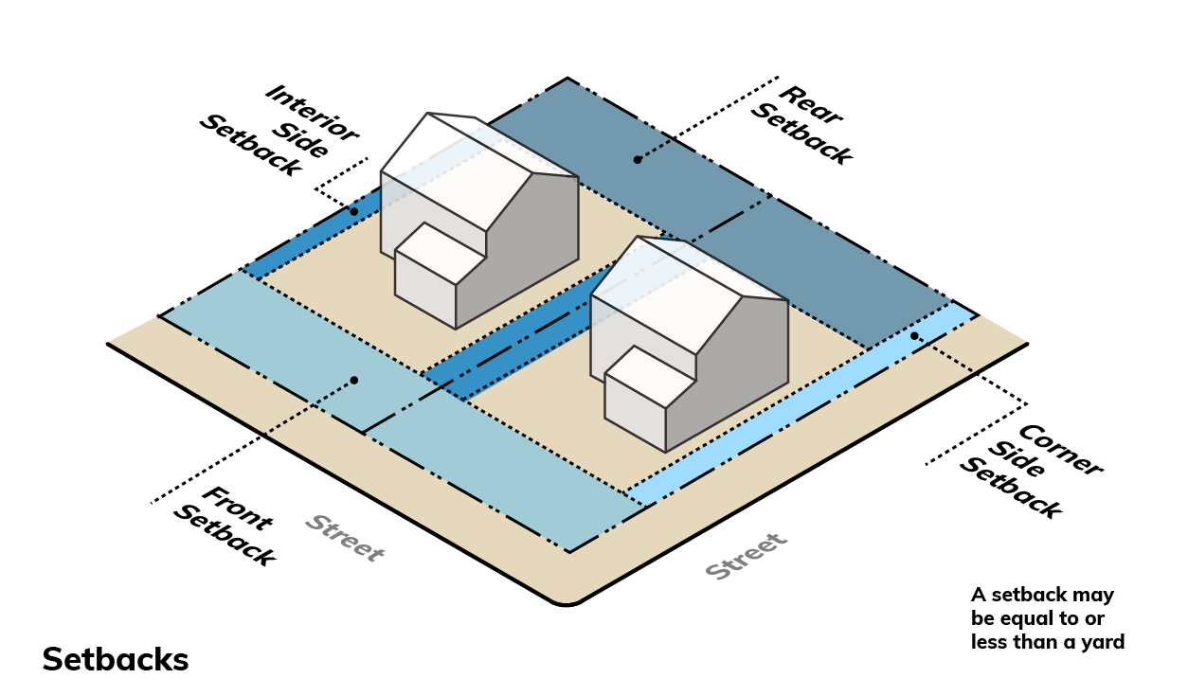
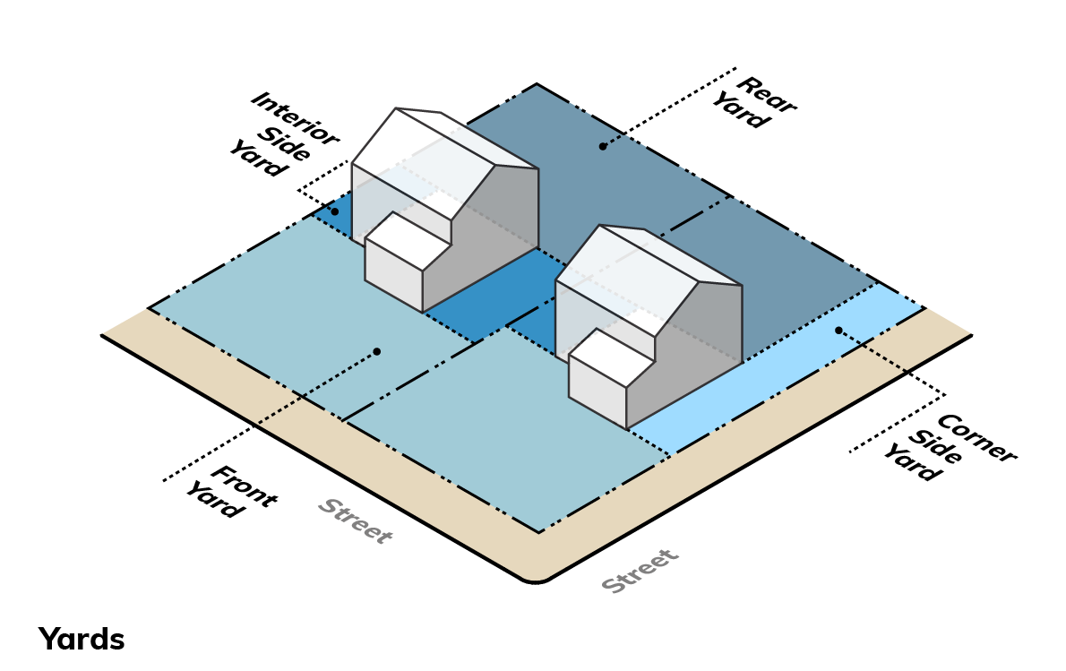
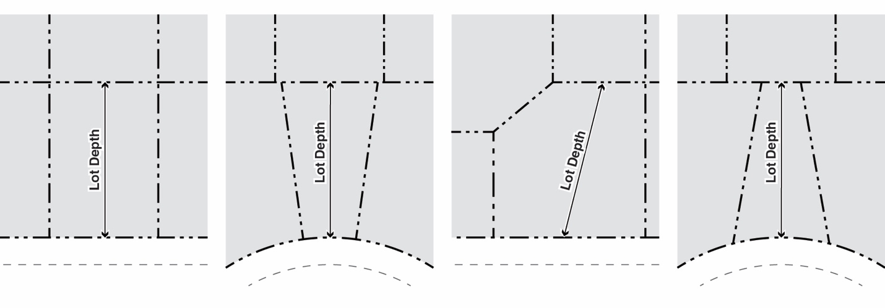
Zoning Code Organization
  Compartmentalized
  Graphic-orientation
  Comprehensive definitions
  Clear measurement methodologies

Slide 3
Zoning Code Organization
Introduction
Chapter 1 Title, Purpose, + Intent
Chapter 2 Definitions + Measurement
Districts
Chapter 3 Zoning Districts + Zoning Map
Chapter 4 Residential Districts
Chapter 5 Business Districts
Chapter 6 Open Space + Recreation Districts
Chapter 7 Uses
Site Standards
Chapter 8 General Development Standards
Chapter 9 Off-Street Parking + Access
Chapter 10 Landscape
Chapter 11 Signs
Administration
Chapter 12 Code Administrators
Chapter 13 Zoning Approvals
Chapter 14 Nonconformities
Chapter 15 Enforcement

Slide 4

Modern Use Approach
Use approach
  Uses tailored to purpose of district
  Use matrix
Generic use categories
  Still call out select uses of concern
  Define each use
Use standards
  Control impacts
Prohibited Uses
  Short-term rentals
  ADUs
  Data centers

Slide 5
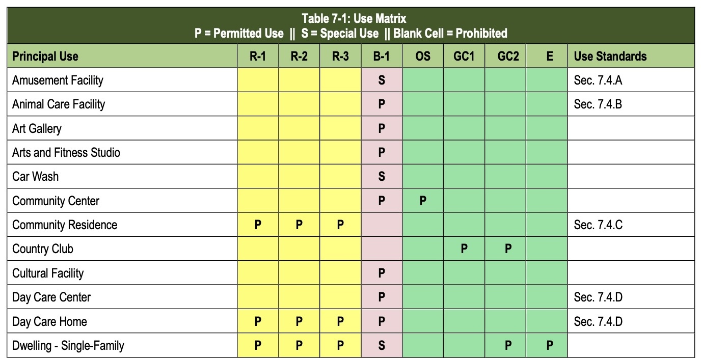
Modern Use Structure
Table utility:
  By district
  By use
Permissions:
Permitted = P
Special = S
Blank = Prohibited

Slide 6
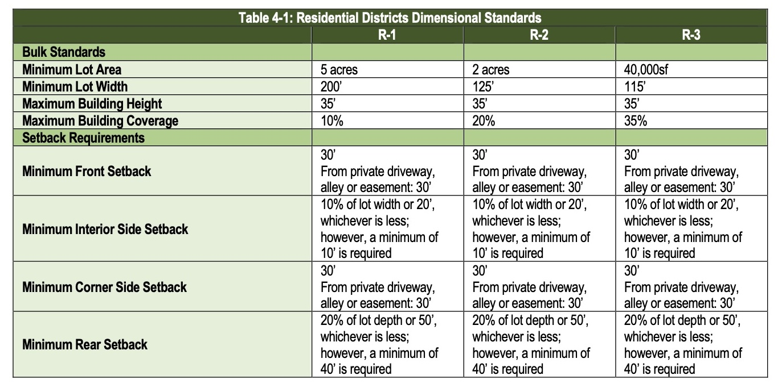
Districts Residential

Slide 7
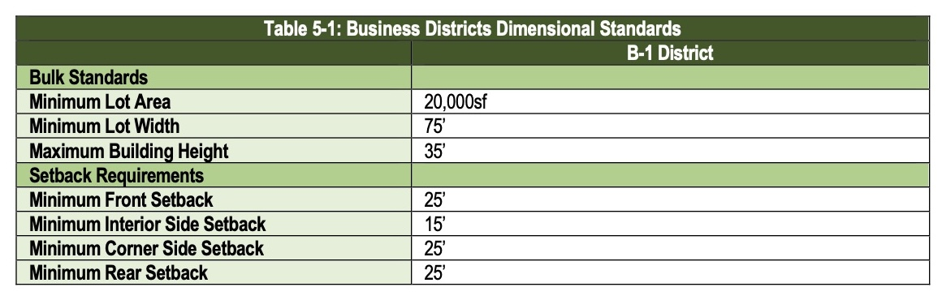
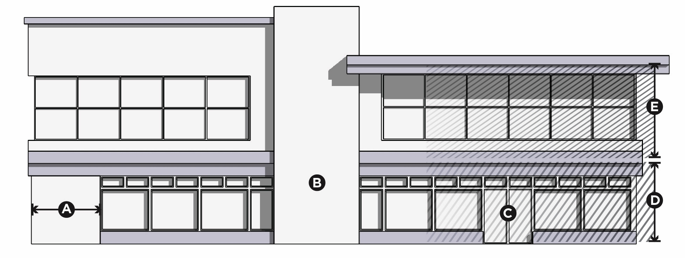
Districts Business
A = Blank wall limitation
B = Repeating architectural feature
C = Prominent entry
D = Ground-floor transparency
E = Upper-floor transparency

Slide 8
Districts Open Space + Recreation
OS Open Space District
Intended to preserve and protect open space, such as parks, playgrounds, + natural areas, for recreational activities + conservation.
GC1 Golf Course District
Intended to accommodate golf courses, driving ranges, + country clubs, providing for recreational spaces + community-oriented activities.
GC2 Golf Course District
** All future development by PUD
Intended to accommodate a mix of golf courses, driving ranges, country clubs, single-family developments, + office spaces in a balanced environment.
E Equestrian Estate District
** All future development by PUD
Intended to accommodate a harmonious mix of equestrian facilities + single-family.

Slide 9
Site Standards General Development
Development regulations of general applicability
General standards
Maximum number of principal structures on a lot
Lot access
Structures prohibited in utility easements
Sight visibility
Exterior Lighting New – compatibility + light pollution controls
Animals Simplified
Keeping of the animals accessory use in R-1 District with 3+ acres
3 animals for every 5 acres with limit of 6 animals
Permitted animals: horses; donkeys; mules; sheep; goats; cattle
Prohibited animals: swine; dangerous animals (per Illinois Compiled Statutes, Federal law, common definition)
Animals must be housed or grazed 200 feet or more from adjacent property owner’s dwelling

Slide 10
Site Standards General Development
Development regulations of general applicability
Fences + Walls Updated + simplified
Fences permitted in front or corner side yard but limited to 36 inches in height + must be open fences (wrought iron, aluminum, or split rail)
All other yards limited to a maximum height of 48 inches
Fence exceptions: animals, swimming pools, sports courts
Material restrictions
Garden fences permitted
Refuse + Recycling New
Prohibit in front + corner side yard
Required enclosure
Outdoor Storage New
Prohibit unless specifically allowed by use standards
Golf course maintenance: 25 feet from lot line

Slide 11
Site Standards General Development
Development regulations of general applicability
Accessory Structures
Prohibited in front or corner side yard (unless allowed by Code)
Sheds limited to 250sf
All other detached accessory structure cannot exceed footprint of principal building
Maximum height: 22 feet
Detached accessory structures must be 15 feet from a lot line
Detached accessory structure connected to a principal structure by an open breezeway, a wall, or extension of a building wall is considered detached
Exterior must be clad in wood, stucco, or brick only, except for greenhouses
Specific Controls
Amateur (ham) Radio Equipment
Bee Hives + Apiary
Chicken Coop + Chicken Yard
Dog Runs
Garage, Detached
Flagpoles
Mechanical Equipment
Solar Panels
Sports Court
Swimming Pool + Hot Tub

Slide 12
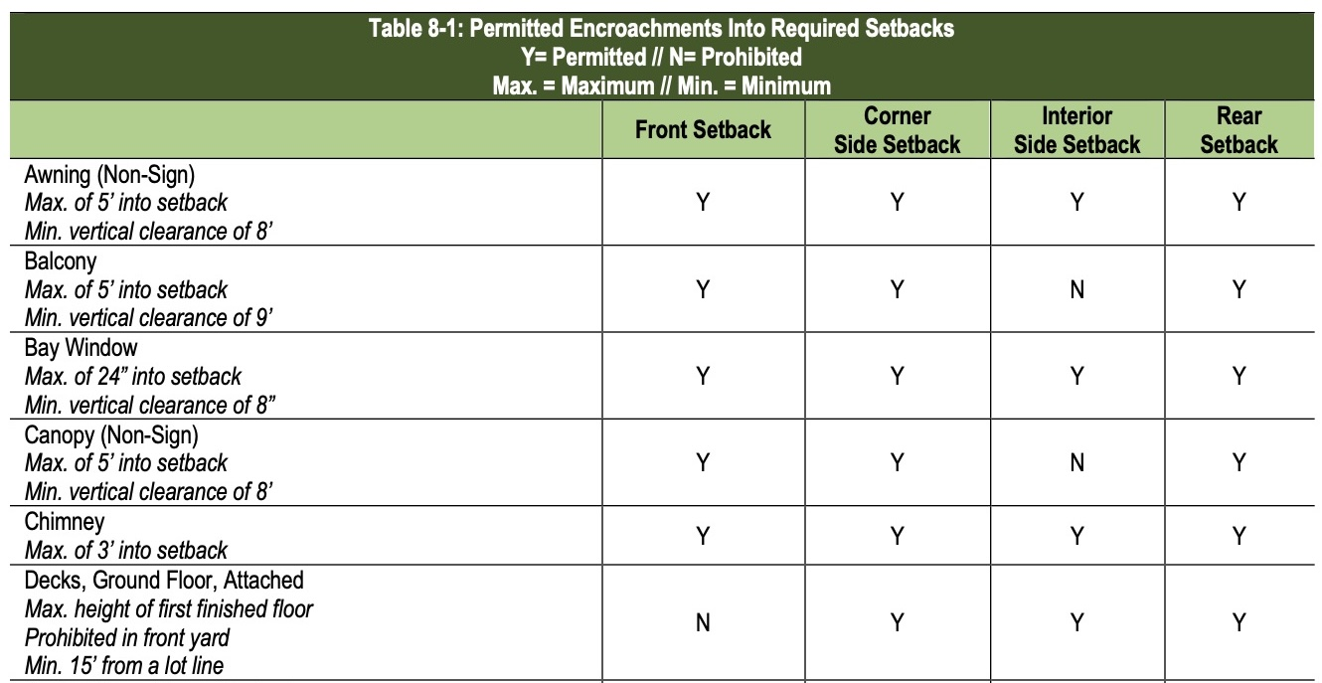
Site Standards Permitted Encroachments
Comprehensive list of architectural features
Awning + canopy (non-sign)
Balcony
Bay window
Chimney
Decks, attached (ground + upper floors)
Eaves, cornices
Pergola, attached
Porch (unenclosed)
Porte-cochere
Sills, belt courses
Stoops + steps

Slide 13
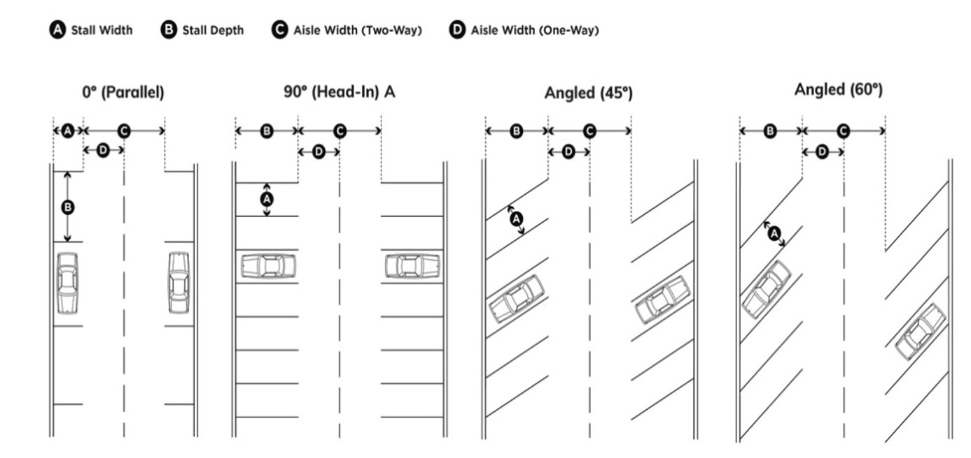
Off-Street Parking Standards
  Comprehensive standards
  General parking facility requirements
  Off-street parking spaces + parking lot location
  Off-street parking facility design
  Commercial vehicle storage
  Recreational vehicle storage

Slide 14
Landscape Requirements
Landscape Plan Required
All development except single-family + two-family
Selection, installation, + maintenance requirements
Minimum installation size
Tree diversity
Native or naturalized species required
Landscape requirements
Parking lot perimeter
Parking lot interior
Buffer yards

Slide 15
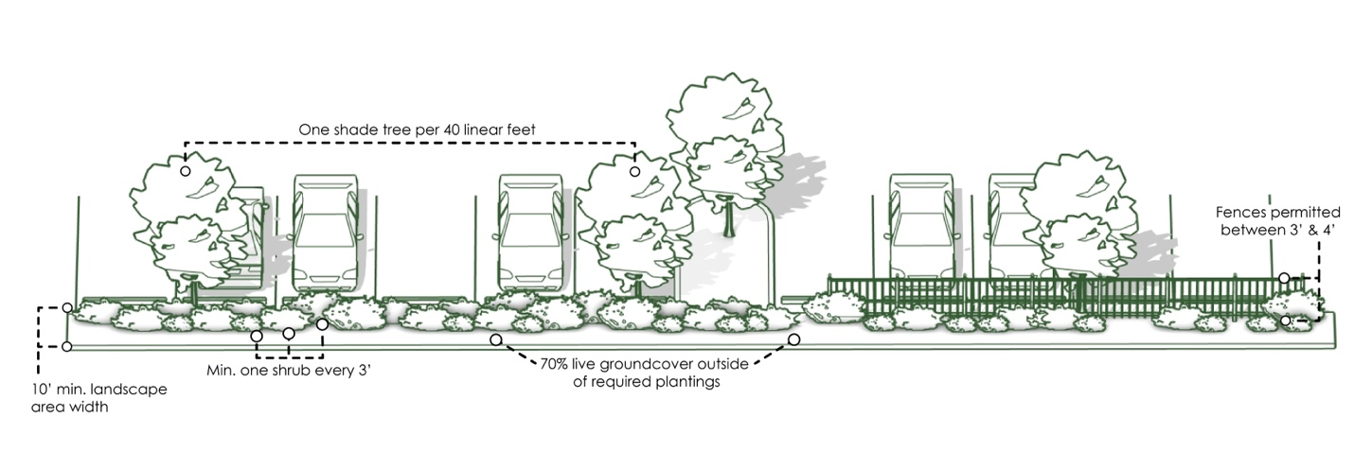
Landscape Requirements
Parking lot perimeter landscape

Slide 16
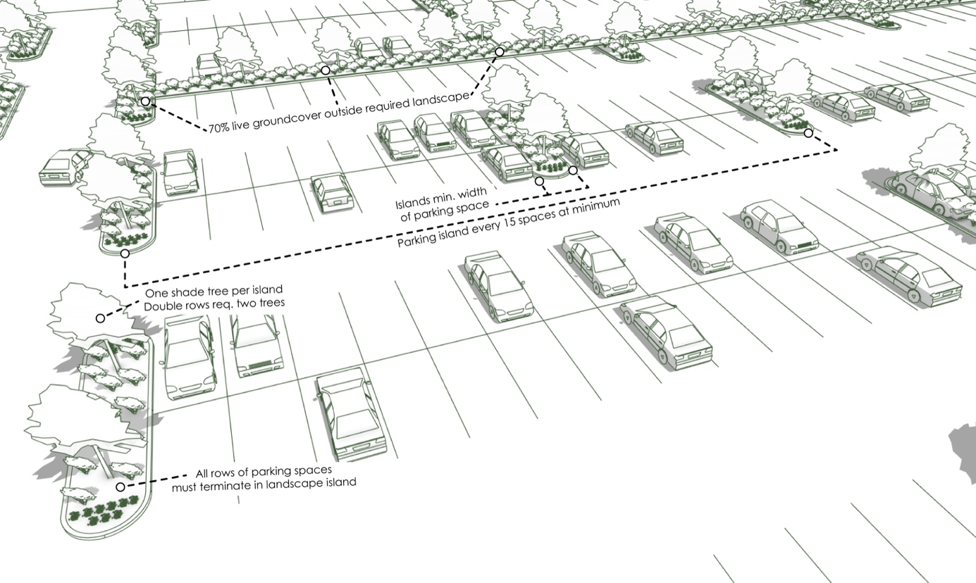
Landscape Requirements
Parking lot interior landscape

Slide 17
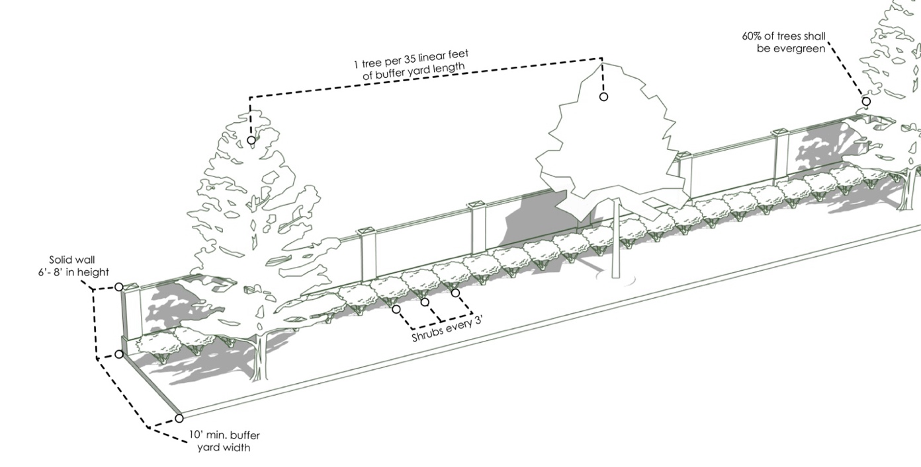
Landscape Requirements
Buffer yard

Slide 18
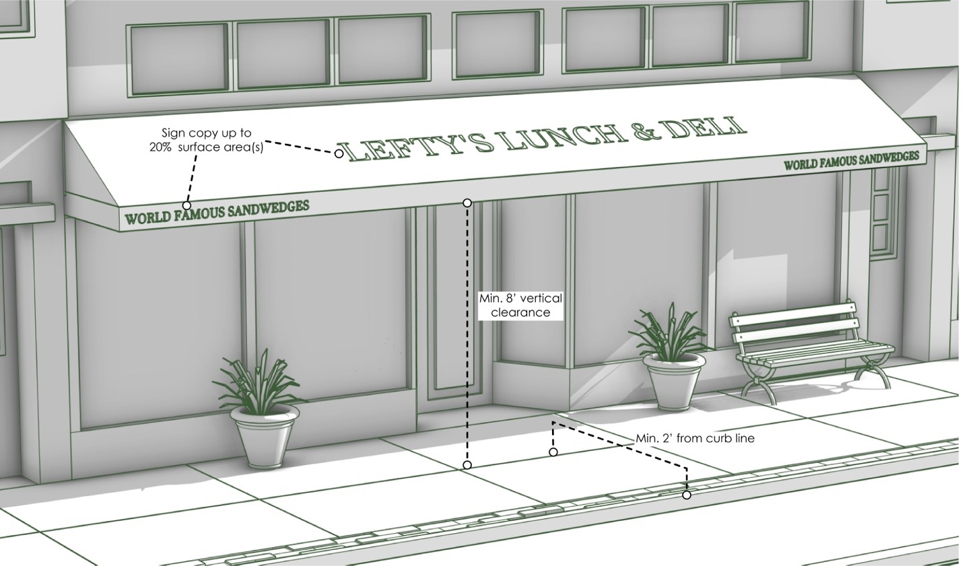
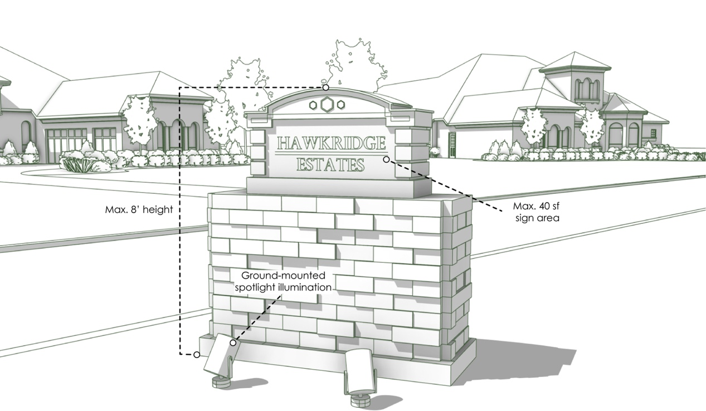
Updated Sign Regulations
  Organization
  Purpose
  General standards
  Illumination
  Prohibited signs
  Exempt signs (no permit required)
  Signs – Permit required
  Content-neutrality

Slide 19
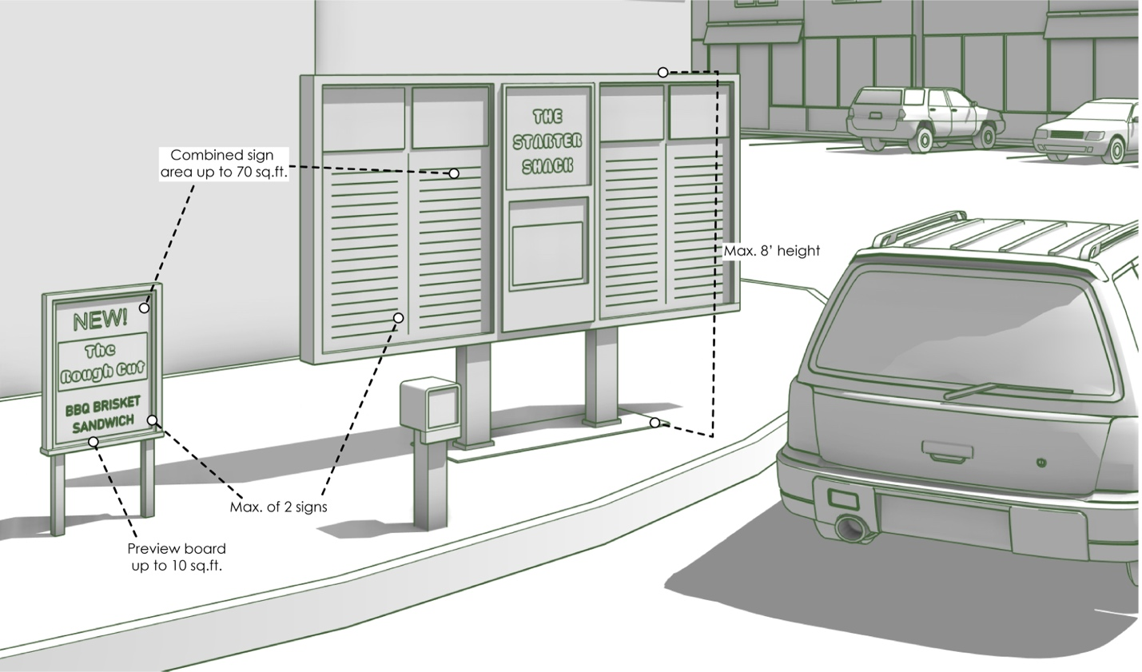
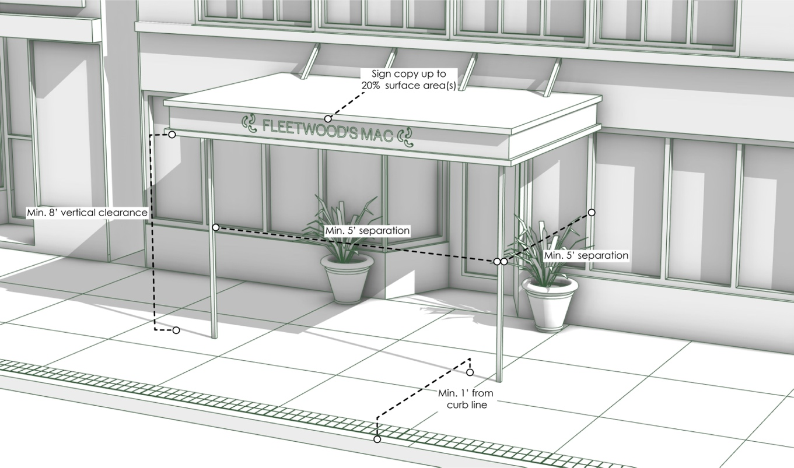
Updated Sign Standards
  Exempt
  Typical signs for certain activities + site elements
  Window signs
  Full range of signs with permit
Awnings
Canopies
Drive-throughs
Ground signs
Wall signs

Slide 20
Zoning Administration
Approval + Permits
Amendments (Text + Map)
Special use
Variances
Planned unit development
Site plan review
Sign permit
Temporary use permit
Zoning interpretation
Zoning Appeals
  Planned Unit Development Updates
  All districts but residential requires 5 acres
  Village Board approves
  Exceptions from district regulations allowed
  Enhanced design + amenities required
Administrators
Village Board
Plan Commission
Zoning Board of Appeals
Building + Zoning Officer

Slide 21
Controls on Nonconformities
Specifically address all nonconformities
Uses
Structures
  Except for SF, 2F: 50% or more requires compliance
  SF,2F: Can rebuild if building permit applied within 1 year
Lots
Site elements
Signs
Flexibilities for nonconforming single-family + two-family dwellings
Expand without variance when encroaching into rear or interior side setback
Allows horizontal and vertical additions
Eaves limited to current encroachment

